Slide 1

DSA0302- Natural Language Processing
Porter Stemmer: Design, Working Mechanism, and Applications
Supervised by:
Presented by:
Dr Devi T
Professor
SIMATS Engineering
Hasini G(192425060)
SIMATS Engineering

Slide 2



INTRODUCTION
Natural Language Processing (NLP) deals with understanding and processing human language.
Before text analysis, words need to be normalized.
Stemming is one of the most important preprocessing techniques in NLP.
Porter Stemmer is one of the most widely used stemming algorithms.

Slide 3
WHAT IS STEMMING?
Stemming reduces words to their base or root form by removing suffixes.
It groups related words together for easier analysis.
It helps reduce vocabulary size in large datasets.
Stemming ignores grammatical variations of words.
It is commonly used during text preprocessing in NLP applications.
Example:
Playing=Play, Played=Play, Running= Run

Slide 4
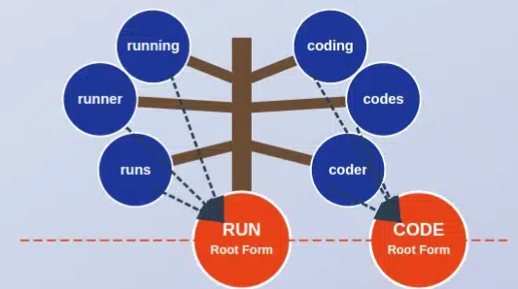
PORTER STEMMER ALGORITHM
Developed by Martin Porter in 1980.
It is a rule-based suffix stripping algorithm.
Uses predefined linguistic rules instead of ML.
Processes words in multiple sequential steps.
Designed mainly for the English language.
Available in popular NLP libraries such as NLTK.
It is computationally efficient for large datasets.

Slide 5
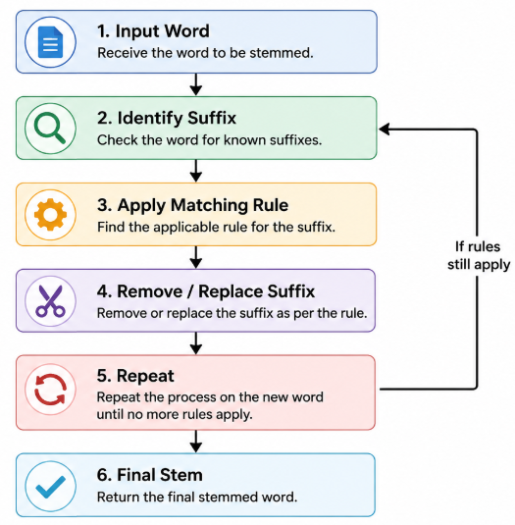
WORKING MECHANISM

Slide 6
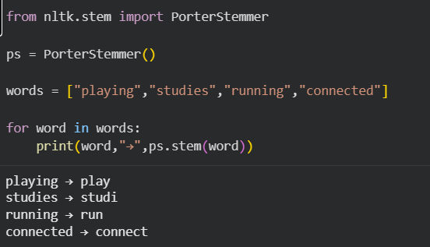
PYTHON IMPLEMENTATION
NLTK provides a built-in PorterStemmer class.
The implementation requires only a few lines of Python code.
It can process thousands of words efficiently.
Suitable for beginners learning NLP preprocessing.

Slide 7
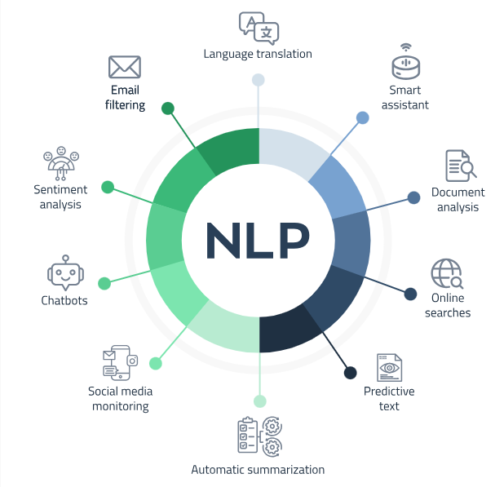
APPLICATIONS

Slide 8

ADVANTAGES & LIMITATIONS
Advantages
Fast and computationally efficient.
Easy to implement.
Reduces storage requirements.
Improves search and retrieval accuracy.
Supported by many NLP libraries.
Limitations
May produce incorrect stems (over-stemming).
Sometimes fails to remove enough characters.
Designed mainly for English.
Does not consider word meaning or context.

Slide 9
CONCLUSION
Porter Stemmer is one of the most popular stemming algorithms in NLP.
It simplifies words into their stem forms using rule-based suffix removal.
It improves text preprocessing efficiency and reduces computational complexity.
It is widely applied in search engines, text mining, and information retrieval.
Although it has limitations, it remains a reliable preprocessing technique for many NLP tasks.

Slide 10
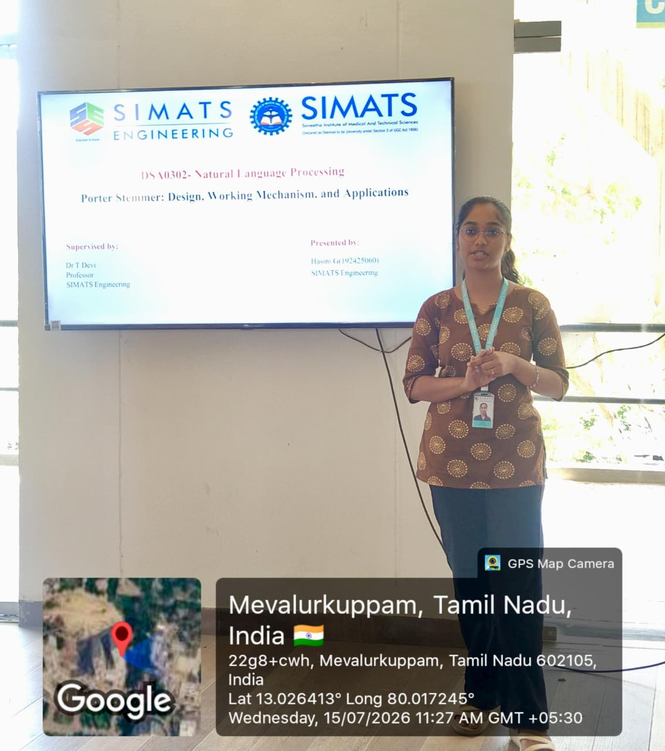

Slide 11
THANK YOU!

